Slide 1
Testing Techniques
Lecture 6a
Madiha Malik

Slide 2
Testing Techniques
Practically, due to time and budget considerations, it is not possible to perform exhausting testing for each set of test data,
Especially when there is a large pool test cases. We need an easy way or special techniques that can select test cases intelligent from the pool of test-case, such that all test scenarios are covered.

Slide 3
Testing Techniques
Equivalence Partitioning
Boundary Value Analysis
Decision Table Testing
State Transition Testing
Use Case Testing
Static Testing (Review)

Slide 4
Equivalence Partitioning
It is a black box technique (code is not visible to tester) which can be applied to all levels of testing like unit, integration, system etc.
In this technique, you divide set of test condition into partition that can be considered the same.

Slide 5
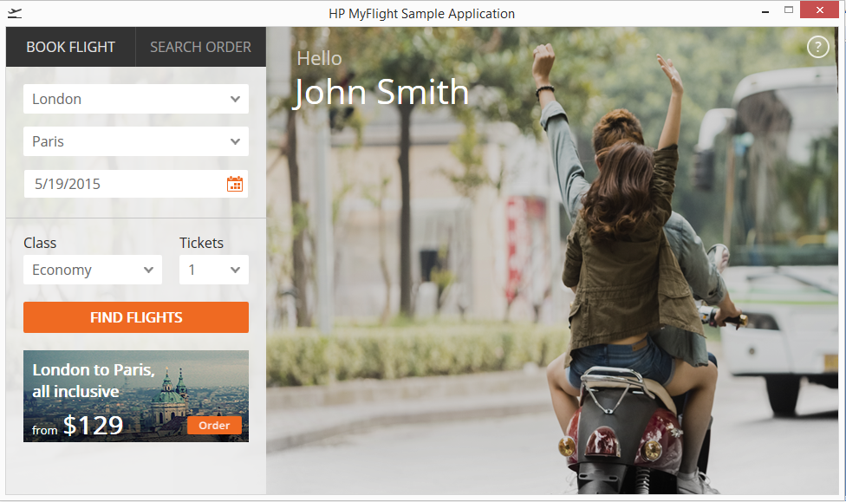
Behavior of No. of Tickets Field
How System Decides, how many reservation users should be allowed
“Only ten tickets may be ordered at one time”

Slide 6
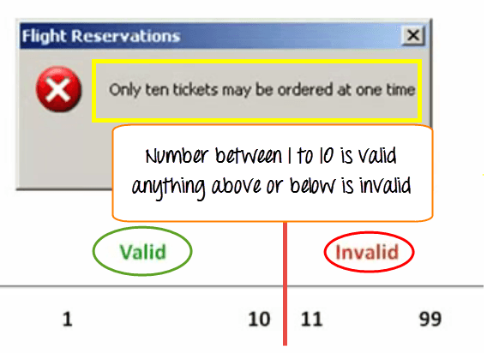

Slide 7
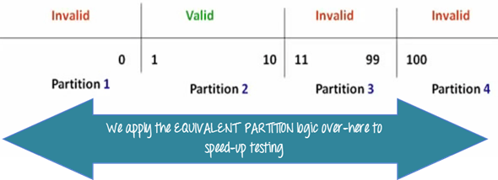
Here is the test condition
Any Number greater than 10 entered in the reservation column (let say 11) is considered invalid.
Any Number less than 1 that is 0 or below, then it is considered invalid.
Numbers 1 to 10 are considered valid
Any 3 Digit Number say -100 is invalid.
The divided sets are called Equivalence Partitions or Equivalence Classes.
Notes:
The divided sets are called Equivalence Partitions or Equivalence Classes.

Slide 8
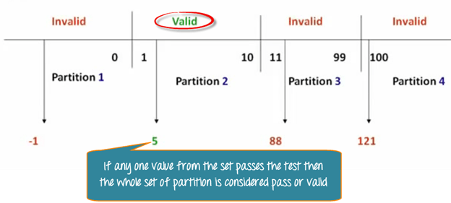
Equivalence Partitioning
We cannot test all the possible values because if done, number of test cases will be more than 100.
we divide the possible values of tickets into groups or sets where the system behavior can be considered the same.
Then we pick only one value from each partition for testing.
The hypothesis behind this technique is that :
if one condition/value in a partition passes all others will also pass. Likewise, if one condition in a partition fails, all other conditions in that partition will fail.

Slide 9
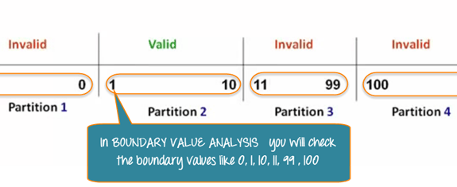
Boundary Value Analysis
It is also a black box technique. in Boundary Value Analysis, you test boundaries between equivalence partitions
In our earlier example instead of checking, one value for each partition you will check the values at the partitions like 0, 1, 10, 11 and so on. As you may observe, you test values at both valid and invalid boundaries.
Boundary value analysis is also called range checking.

Slide 10
Equivalence partitioning and boundary value analysis are closely related and can be used together at all levels of testing.

Slide 11
Decision Table Testing
Decision table testing is a good way to deal with a combination of inputs, which produce different results.

Slide 12
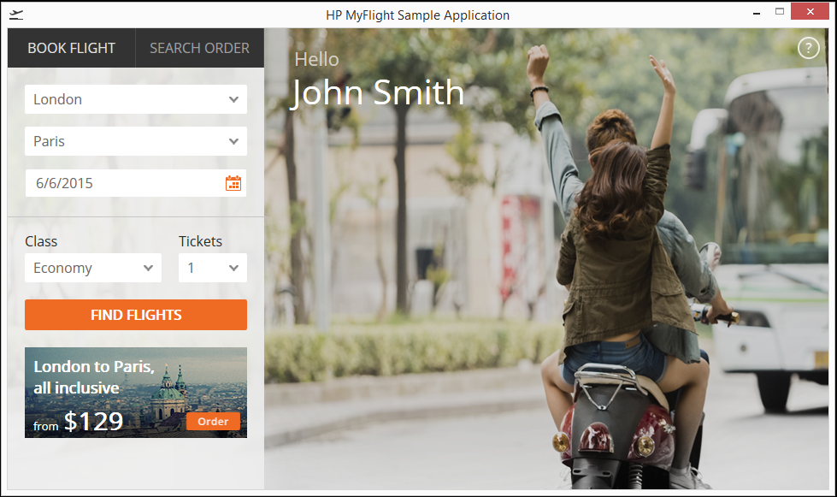
Behavior of Flights Button
Notes:
Example: To understand the importance of Decision Table Making we will see an example, let's consider the behavior of Flight Button for different combinations of Fly From & Fly To

Slide 13
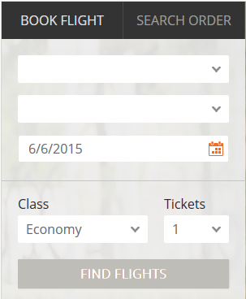
Rule 1
Conditions | Rule 1 | Rule 2 | Rule 3 | Rule 4
FLY FROM | F
FLY TO | F
OUTCOME FLIGHTS BUTTON | F
When destination for fly form and fly to is not set, the outcome will be False.
(Flights button disabled)
Notes:
Rule 1:When destination for both Fly From & Fly To are not set the Flight Icon is disabled. In the decision table, we register values False for Fly From & Fly To and the outcome would be False, which is Flights Button will be disabled. Likewise, you can decide different outcome for different situation.

Slide 14
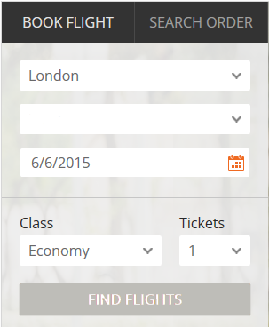
Rule 2
Conditions | Rule 1 | Rule 2 | Rule 3 | Rule 4
FLY FROM | F | T
FLY TO | F | F
OUTCOME FLIGHTS BUTTON | F | F
Notes:
Rule 2: When Fly From destination is set but Fly to is not set, Flight button is disabled. Correspondingly, you register True for Fly from destination in the decision table, and the rest of the entries are false.

Slide 15
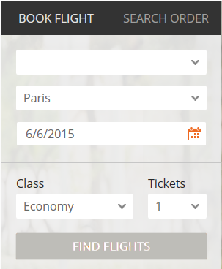
Rule 3
Conditions | Rule 1 | Rule 2 | Rule 3 | Rule 4
FLY FROM | F | T | F
FLY TO | F | F | T
OUTCOME FLIGHTS BUTTON | F | F | F
Notes:
Rule 3: When Fly from destination is not set but Fly to destination is set, Flight button is disabled and you make entries in the decision table.

Slide 16
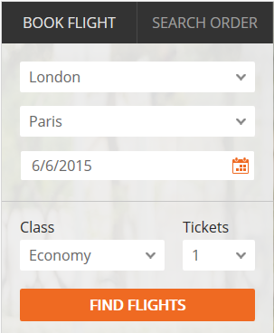
Rule 4
Conditions | Rule 1 | Rule 2 | Rule 3 | Rule 4
FLY FROM | F | T | F | T
FLY TO | F | F | T | T
OUTCOME FLIGHTS BUTTON | F | F | F | T
The final outcome will only true when fly from and fly to destination is mentioned.
Notes:
Rule 4: only when Fly to and Fly from destinations are set, Flights button is enabled and you make the corresponding entry in the decision table.

Slide 17
Decision Table Testing (cont.)
Obviously, You cannot test all but will choose a rich subset of the possible combinations using Decision Based Testing Technique.
The Significance of this technique becomes immediately clear as the number of inputs increases.
Number of possible combinations is given by 2^n, where ‘n’ is the number of inputs.
For n=10, which is very common in the Web-Based Testing.
Having big input forms, the number of combinations will be 1024.

Slide 18
State Transition Testing
State Transition Testing Technique is helpful where you need to test different system transitions.

Slide 19

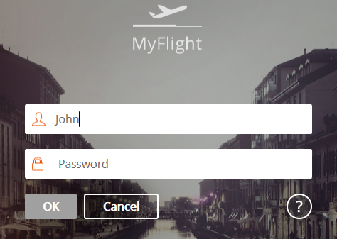
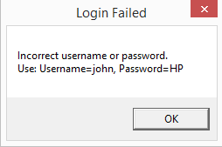
State Transition Diagram
Incorrect Password
Close Application
Enter Agent Name
2nd Try
1st Try
3rd Try
Start
4th Try
Correct Password
Correct Password
Access
Notes:
So, testing for scenario 1 with the correct password and the 4th scenario with an incorrect password is compulsory, for that we use state transition testing.

Slide 20
State Transition Diagram
Incorrect Password
Close Application
Enter Agent Name
2nd Try
1st Try
3rd Try
Start
4th Try
Correct Password
Correct Password
Access
So, testing for scenario 1 with the correct password and the 4th scenario with an incorrect password is compulsory, for that we use state transition testing.

Slide 21
State Table - Invalid Transitions
What happens when you are already logged into the application and you open another instance of flight reservation and enter valid or invalid passwords for the same agent.
System response for such a scenario needs to be tested.
Valid States | Correct Password | Incorrect Password
S1) Start | S6 | S2
S2) 1st Try | S6 | S3
S3) 2nd Try | S6 | S4
S4) 3rd Try | S6 | S5
S5) 4th Try | S6 | S7
S6) Access | ? | ?
S7) Close Application

Slide 22
Use Case Testing
The Use-Case Testing technique helps identifying test cases that cover the entire system, on a transaction by transaction basis from the start to finish.
A use case is a description of a particular use of the system by an actor or user. It is used widely in developing tests at system or acceptance level.

Slide 23
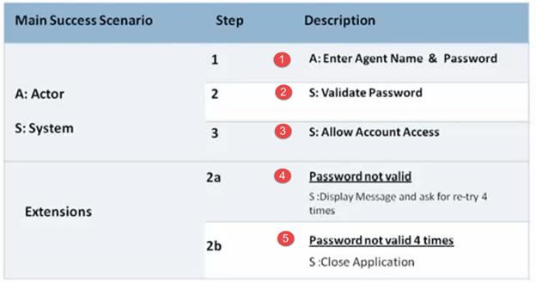
Use Case Testing
Here we will test the success scenario and one case of each extension. This is USE-Case testing

Slide 24
Static Testing (Review)
In simple words review is a meeting where people analyze a software work product and recommend changes with the objective of improving quality.
The software work product: a design document, SRS, code, Test Plan etc.
It helps in detecting defects early in the SDLC and reduces cost.
Almost always the testing team is part of the review meetings.

Slide 25
Functional Design Document
F-48
Add a function to send an order via EMAIL
Fields
Email ID
Recipient Name
Button
Send
Notes:
To understand the review in detail lets consider an example. To add email functionality to flight reservation system. For which the FDD is prepared by the technical lead, he approaches his manager and request to initiate the review

Slide 26
Planning Stage
F-48
Add a function to send an order via EMAIL
Feilds
Email ID
Recipient Name
Buton
Send
Notes:
The manager will quickly go through the document and check whether the document is of acceptable quality to request the review by other people, e.g. he finds few spelling mistakes and ask the technical lead to correct them.

Slide 27
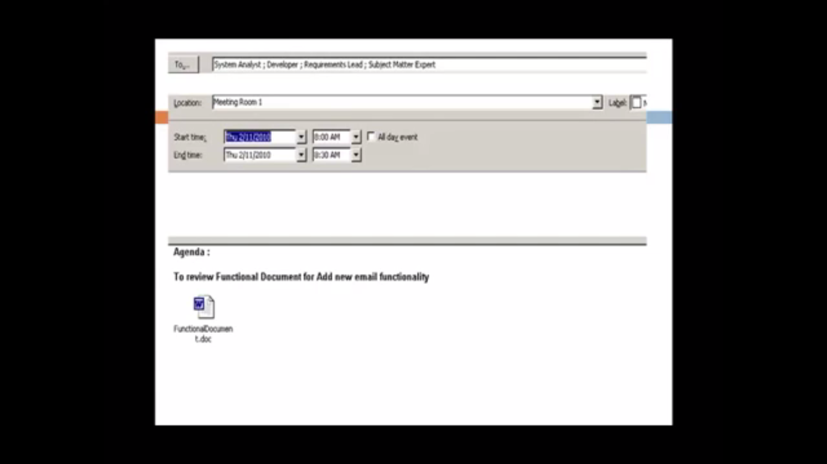
Planning Stage
Notes:
Once corrected the manager will send out the meeting request to all stakeholders along with meeting location, date and time of meeting and agenda for meeting and attach the FDD for reference.

Slide 28
Kick Off Meeting
Its an optional stage
Goal is to get everybody on the same wavelength regarding document under review.
Is beneficial for new or highly complex projects.

Slide 29
Preparation Stage
Review meeting participants individually go through the document to identify defects, comments and questions to be asked during review meeting.
This phase is necessary to ensure that during the meeting participants focus on subject in-hand instead of day-dreaming.

Slide 30
Exercise
F-48
Add a function to send an order via EMAIL
Fields
Email ID
Recipient Name
Button
Send
Notes:
This the exercise for this FDD, think of the details missing required to help you test this functionality.

Slide 31
Review Meeting
Here the meeting participants are assigned different roles to increase the effectiveness of the meeting.
Moderator
Author
Reviewer
Scribe/Recorder.

Slide 32

Roles of meeting
Moderator
The Moderator: a role usually played by the manager leads the meeting and sets the agenda.

Slide 33
Roles of Meeting
Author
The creator of the document, under review plays the role of AUTHOR, who reads the document and invites comments.

Slide 34
Roles of Meeting
Reviewer
The task of the Reviewer is to communicate any defects in the work product.

Slide 35
Functional Design Document
F-48
Add a function to send an order via EMAIL
Fields
Email ID
Recipient Name
Button
Send
Suppose one of the reviewer said that it would be nice to have a reset button. The author agrees to the suggestion.

Slide 36
Another review comment is: there is no mention is to where in the menu item the email functionality will appear, again the author accepts and agrees to make changes

Slide 37
Roles of Meeting
Scribe
The meeting participant playing the role of scribe also known as recorder) , will note down these defect or suggestion

Slide 38
Roles of Meeting
Reviewer
One young reviewer suggests the possibility to share the ticket via Social Networking sites like Facebook, Orkut and so on.

Slide 39
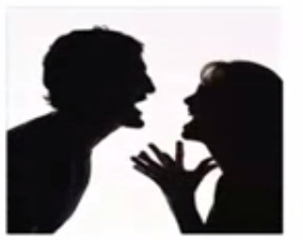
Roles of Meeting
Author
Reviewer
Notes:
The author strongly disagrees to this and the reviewer and the author enter into a heated argument, at this stage the moderator intervenes and find the solution to ask from the client.

Slide 40
Roles of Meeting
Moderator
The Moderator: Ask the client whether he needs sharing via social networking

Slide 41
Review Meeting
Sr# | Review Comments
1. | Add Reset Button
2. | Add Detail about Menu
3. | Ask the client about facility to share via social networking sites.
Notes:
Finally all comments are discussed and the scribe gives a list of defects, comments, suggestions and the moderator closes the review meeting.
The moderator and scribe can also play the role of reviewer, meaning they can give review comments to the author.

Slide 42
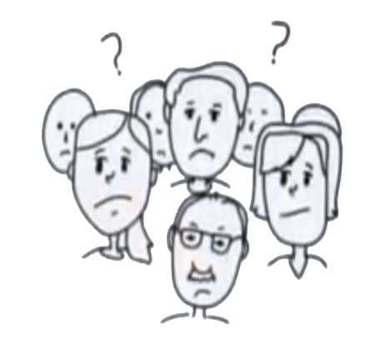
Roles of the Meeting
Moderator
Scribe/ Recorder
Reviewers
Author
Notes:
The moderator and scribe can also play the role of reviewer, meaning they can give review comments to the author.

Slide 43
Re-Work
The author will make changes in the document as per the review comments of the meeting.
Sr. # | Review Comment | Status
1. | Add Reset Button | Done
2. | Add Detail about Menu | Done
3. | Ask the Client about facility to share via Social Networking Sites | Not Valid, Client does not need it.

Slide 44
Follow-Up
The Moderator will circulate the reworked document to all review participants to ensure that all changes have been included.

Slide 45

Review Stages
Planning
Kick-Off
Review Meeting
Re-Work
Follow-Up

Slide 46
Types of Review
Walk through: which is led by Author
Technical Review: which is led by Trained Moderator with no management participation
Inspection: Led by Trained Moderator and uses entry-exit criteria.

